Slide 1
Multipath propagation
Notes:
1

Slide 2
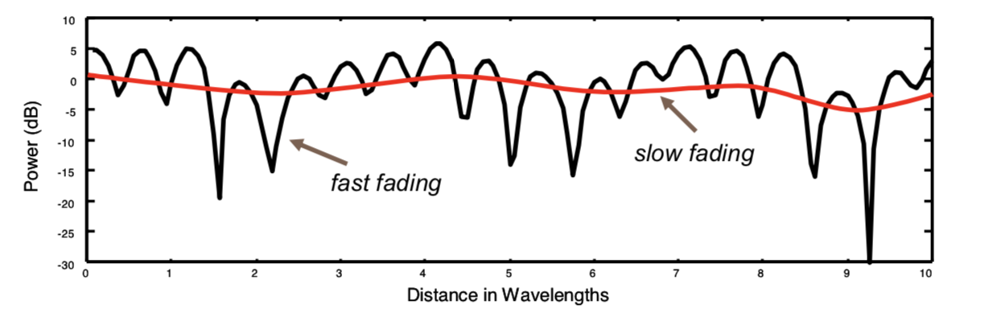
Fast Fading
Amplitude and phase change significantly as user moves
This can be attributed to the phasor addition of multipath signals
Notes:
Frequency is rate of change of phase

Slide 3
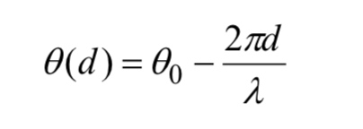
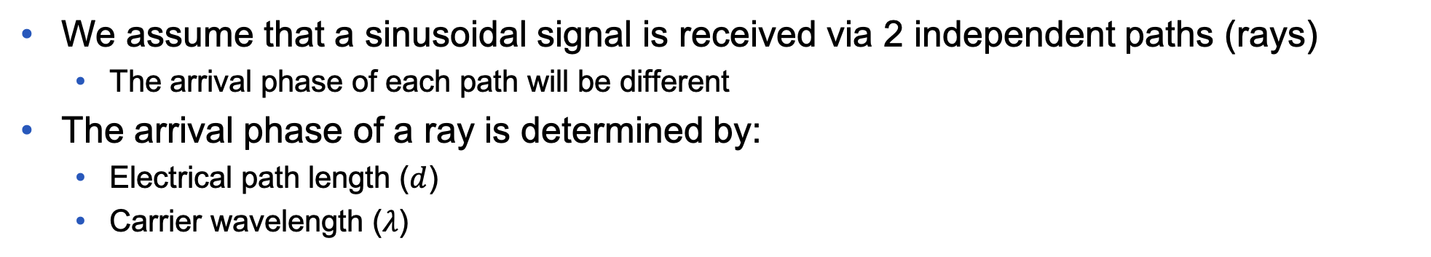
Arrival Phase of a ray (1)
We assume that a sinusoidal signal is received via 2 independent paths (rays)
The arrival phase of each path will be different
The arrival phase of a ray is determined by:
Electrical path length ($d$)
Carrier wavelength ($λ$)
Path length
Initial phase of ray
Carrier wavelength
Notes:
Frequency is rate of change of phase

Slide 4
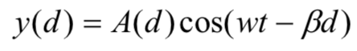
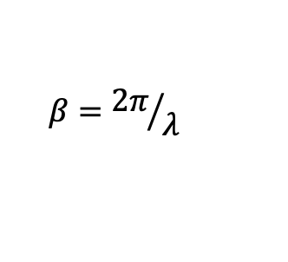
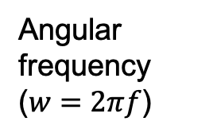
Arrival Phase of a ray (2)
Amplitude (distance dependent)
Angular frequency ($w=2πf$)
Equation for a given path:
$$β={2π}/λ$$
As user moves, the path length varies, the phase of ray changes as well
If 2 rays arrive in phase --- constructive interference (PEAK)
If 2 rays arrive in anti-phase (180 degrees apart) --- destructive interference (FADE or CANCEL)
Since many rays arrive at the receiver, usually the probability of cancellation is really small
Notes:
Frequency is rate of change of phase

Slide 5
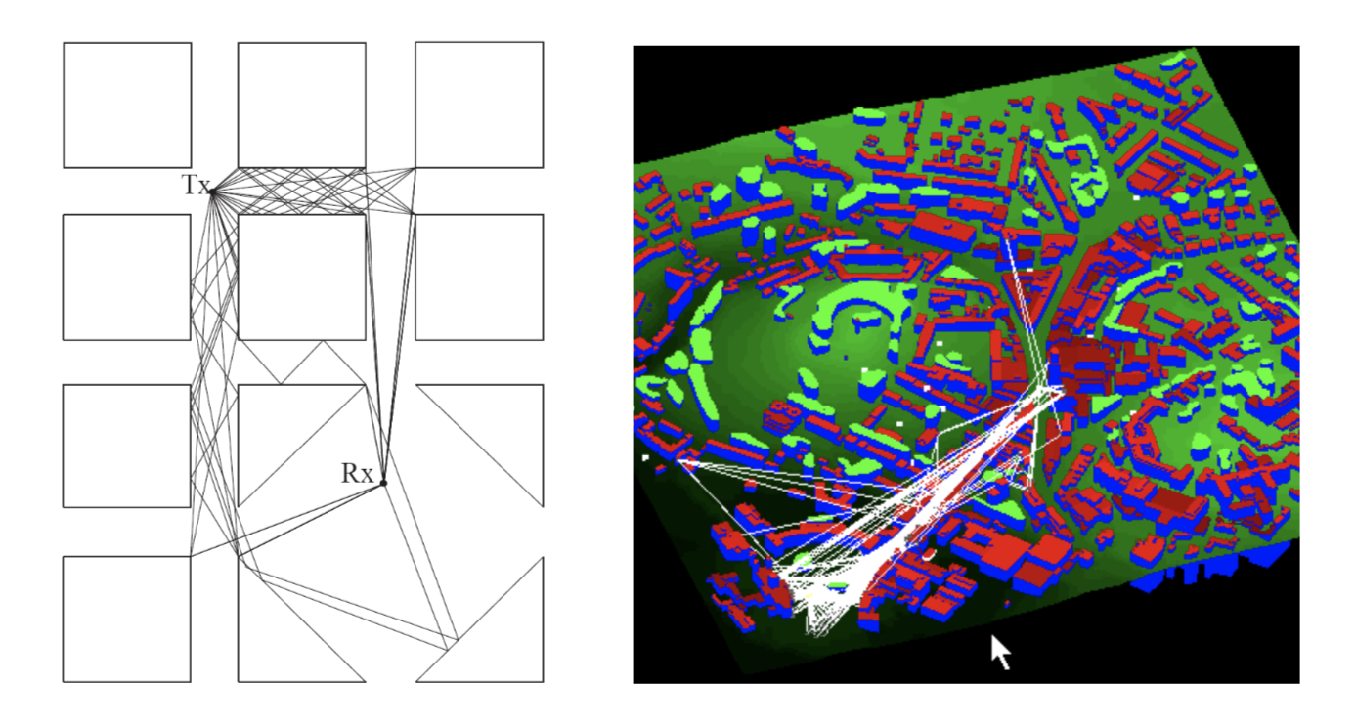
Multipath Propagation
Various diffracted and reflected multipaths linking Rx-Tx
Urban multipaths from a Tx (Wills Building) to a mobile at the bottom of Park Street

Slide 6
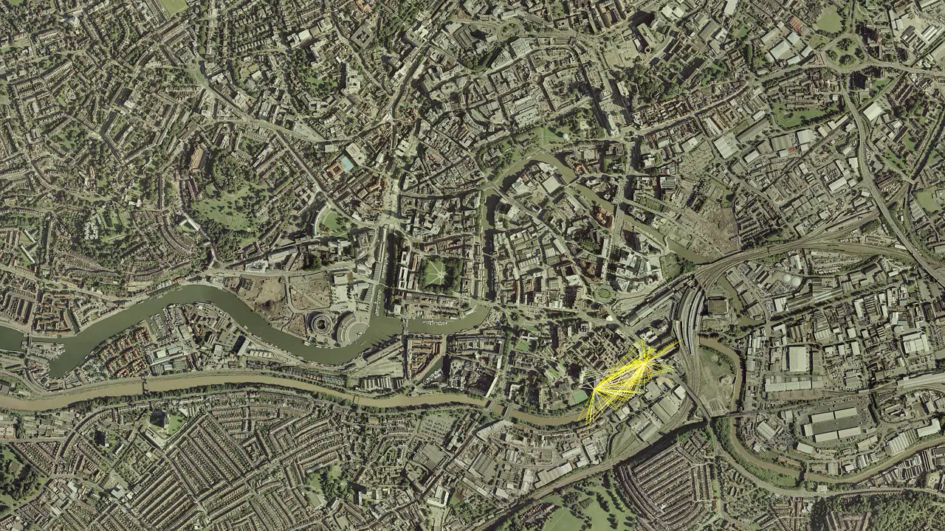

Slide 7
Multipath scenarios
Simplest path scenario
Based on 2 arriving rays (paths)
Two paths have similar amplitude: Rayleigh scenario
Usually we assume at least 8 multipaths
In many mobile scenarios, one multipath arrives at Rx with far more power than the rest (dominant path) – usually LoS case
Also Non-LoS when we have a strong reflector
One path arrives with more power: Rician scenario
Vector summation is more deterministic (less variations)

Slide 8
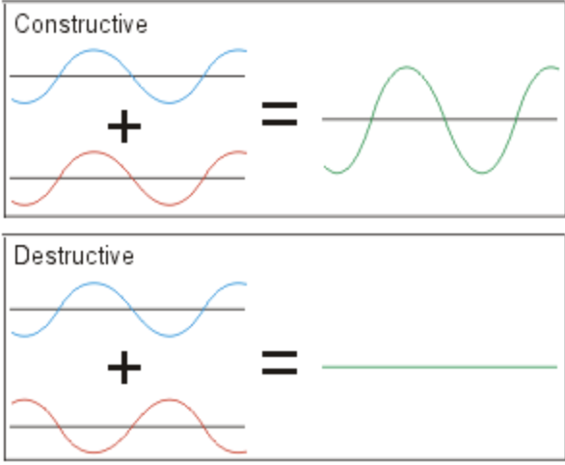
Rayleigh Distribution
In-phase:
Anti-phase:

Slide 9
Rician Distribution
One path arrives with more power --- dominant path
Amplitude and phase transients less severe
As amplitude ratio between rays increases, signal becomes more deterministic
The degree of variation is characterised by the K-factor

Slide 10
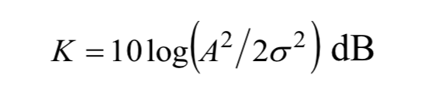
K-factor
K-factor defines degree of variation
envelope power of dominant components
envelope power of random components
No dominant component (Rayleigh), then K-factor small/negative (dB)
A strong dominant path (Rician), then 5dB < K-factor < 10dB
Notes:
All equations good for systems with dominant strong Line of Sight (satellite and microwave p2p comms…where multipaths with mobile radio apps not that good

Slide 11
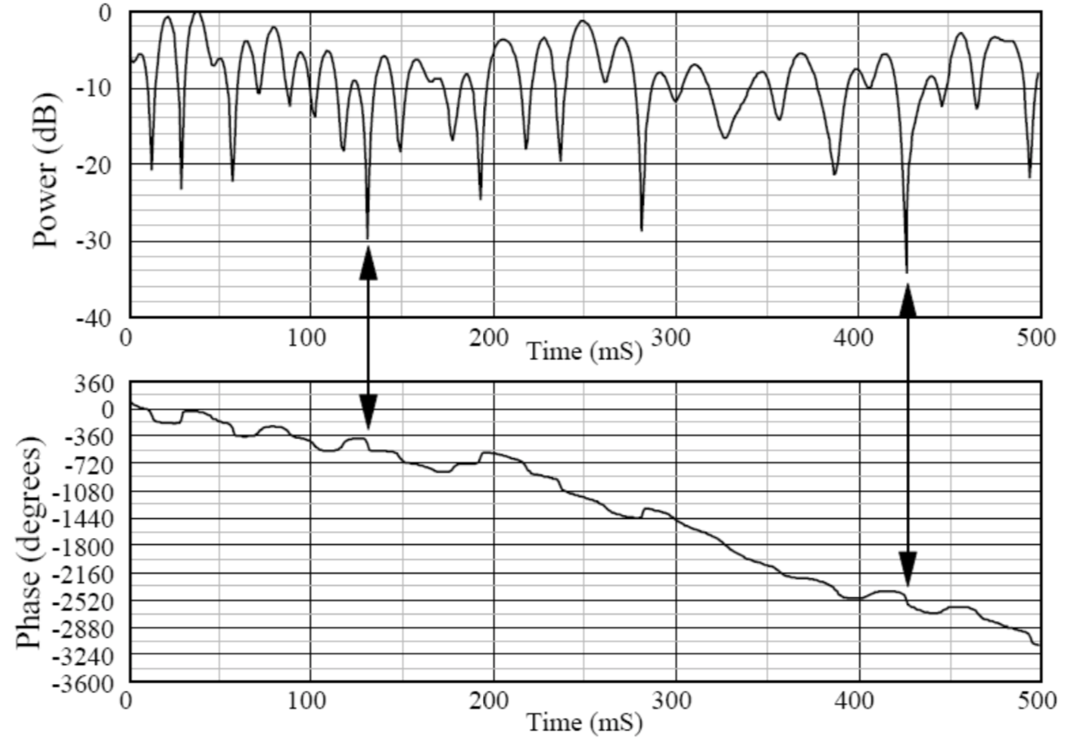
Envelope and Phase Variations (Rayleigh)
Assuming 8-ray scenario:
Deep envelope fades, are seen

Slide 12
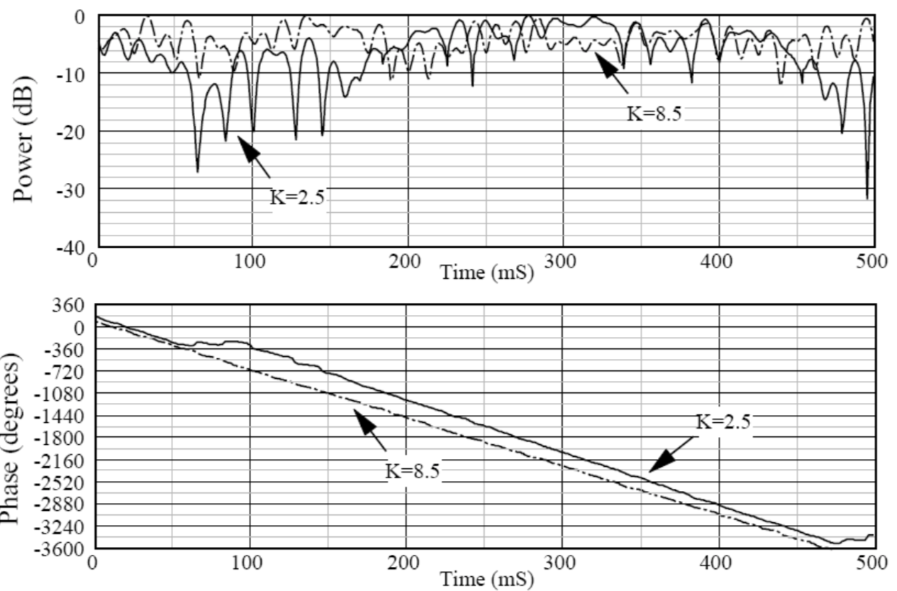
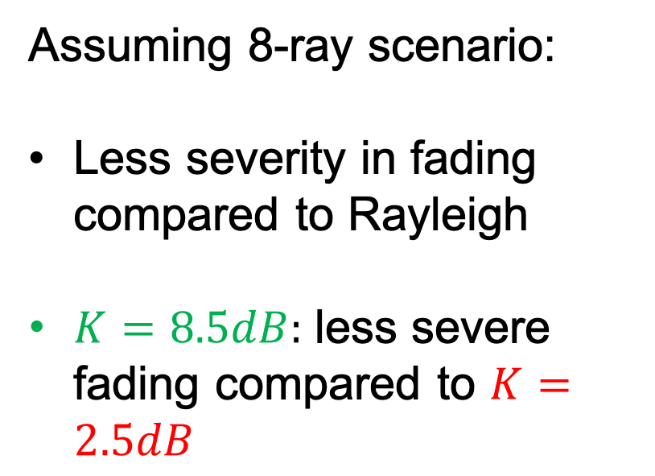
Envelope and Phase Variations (Rician)
Assuming 8-ray scenario:
Less severity in fading compared to Rayleigh
$K=8.5dB:$ less severe fading compared to $K=2.5dB$

Slide 13
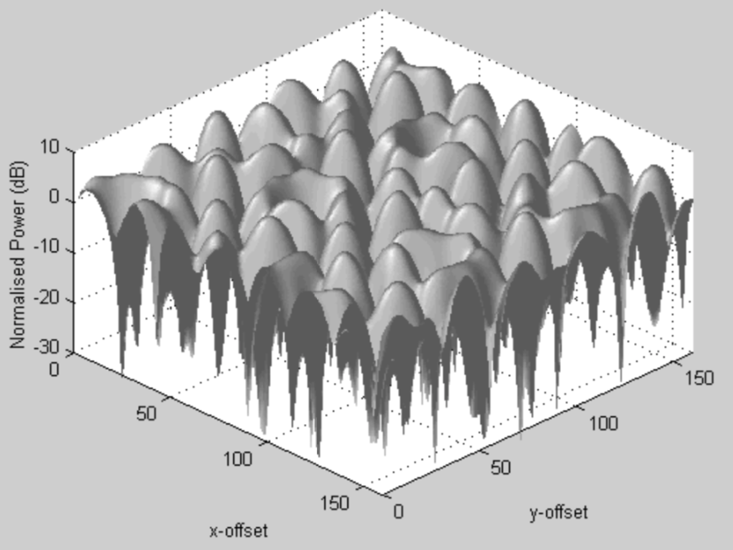
Rayleigh fading over rectangular area
Fading over a rectangular area (i.e. room)
Small movements in space result in changes in the envelope (amplitude)
Deep fades can be 40dB below the signal peaks

Slide 14
Delay Dispersion (1)
Multipath signals arriving at the receiver, take unique paths
Experience a different time of flight
The difference in the time of flight, results in time dispersion between the multipaths at the receiver

Slide 15
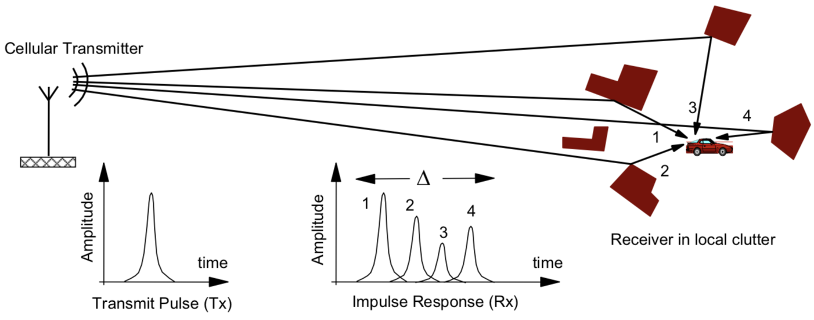
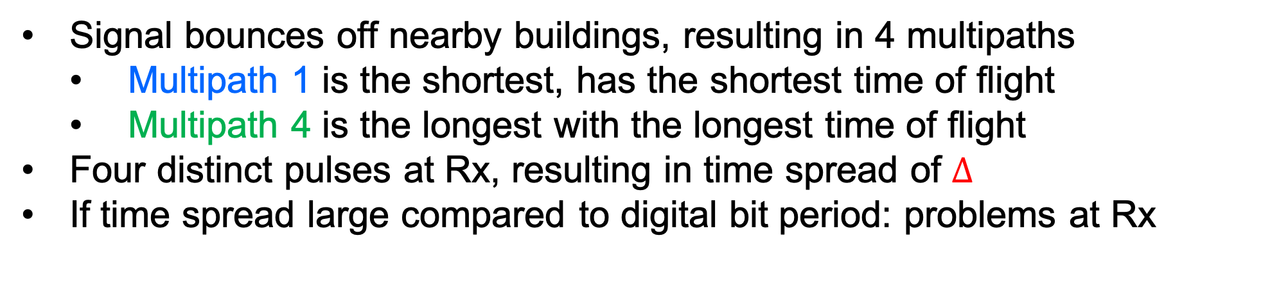
Delay Dispersion (2)
Signal bounces off nearby buildings, resulting in 4 multipaths
Multipath 1 is the shortest, has the shortest time of flight
Multipath 4 is the longest with the longest time of flight
Four distinct pulses at Rx, resulting in time spread of $∆$
If time spread large compared to digital bit period: problems at Rx
As tx rate increases → bit period decreases → time dispersion becomes a limiting factor

Slide 16
Power Delay Profile (1)
The time dispersive nature of the channel is characterised by the Power Delay Profile (PDP)
Obtained by plotting the power of each multipath against its time of flight
Sometimes, time of flight is normalised relative to the time of the first arriving ray
time axis represents relative delay

Slide 17
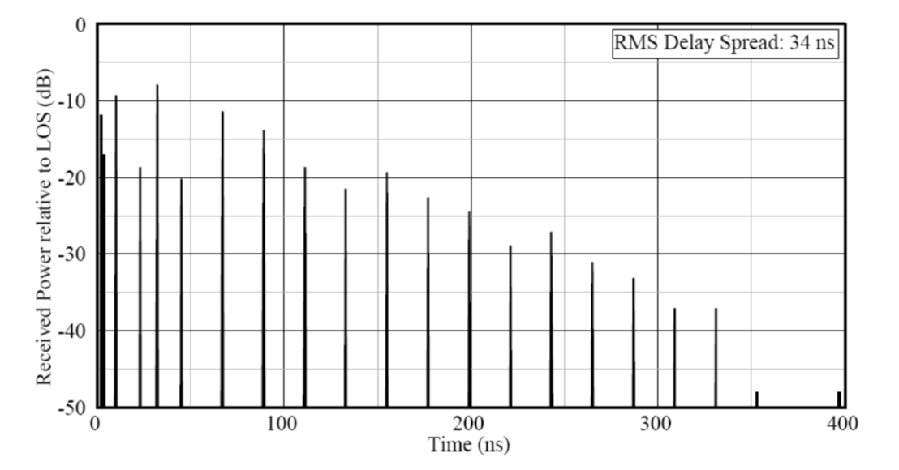
Power Delay Profile (2)
Theoretic indoor PDP shown
Usually, the first rays to arrive, have the largest amplitude (shortest distance)
magnitude tends to fall away as the time delay increases (due to path loss, reflection/diffraction loss)
We quantify the degree of dispersion in
a channel by using its
Root Mean Square (RMS) delay spread

Slide 18
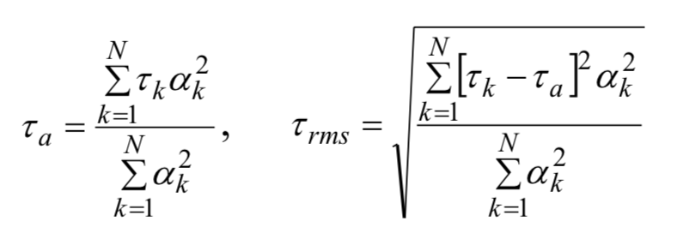
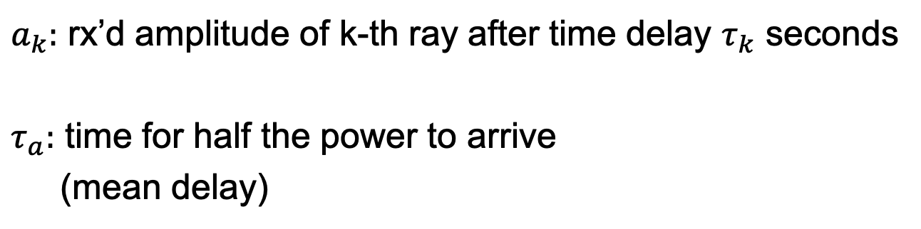
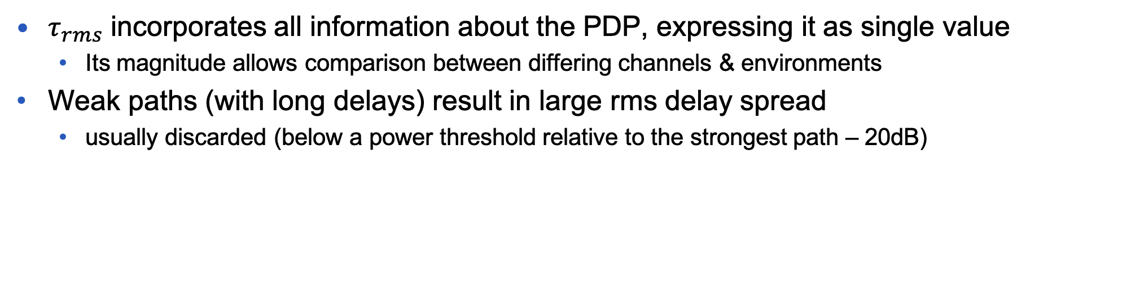
RMS delay spread
$a_{k}:$ rx’d amplitude of k-th ray after time delay $τ_{k}$ seconds
$τ_{a}:$ time for half the power to arrive
(mean delay)
$τ_{rms}$ incorporates all information about the PDP, expressing it as single value
Its magnitude allows comparison between differing channels & environments
Weak paths (with long delays) result in large rms delay spread
usually discarded (below a power threshold relative to the strongest path – 20dB)

Slide 19
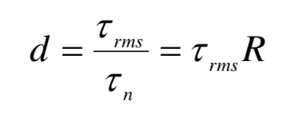
Normalised RMS delay spread
Digital Transmissions: the value is normalised to the transmission bit rate $R$ or bit period $τ_{n}$
An unequalised digital system generates a BER of 1 in 1000 for a normalised rms delay spread of 0.1.
Equalisation: DSP performed to correct for time delay spread (or frequency selective fading)
Digital Modems, supporting high data rates, include some form of equalisation to account for the effects of delay spread

Slide 20
Time dispersive/Frequency selective (1)
Maximum bandwidth supported without need of equalisation in time dispersive, or frequency selective channel, is known as Coherence Bandwidth
The bandwidth over which the frequency response of the channel is flat
The frequency separation required between two tones for the envelope fading correlation to fall to 0.5
Time dispersive/Frequency selective fading
Bandwidth is large --- WIDEBAND channel
Bandwidth of the channel > Coherence Bandwidth
Short symbol period that allows all multipaths to get analysed (we get the symbol at every multipath at the Rx --- many copies of the signal)
Notes:
Frequency is rate of change of phase

Slide 21
Time dispersive/Frequency selective (2)
Flat fading
Narrow bandwidth --- NARROWBAND channel
Bandwidth of the channel < Coherence Bandwidth
Symbol period is large relative to how long it takes the multipaths to arrive
For example 5 sec for all multipaths to arrive, whereas the symbol time is 100sec
Power Delay Profile before
Now we look at the frequency domain channel response
Notes:
Frequency is rate of change of phase

Slide 22
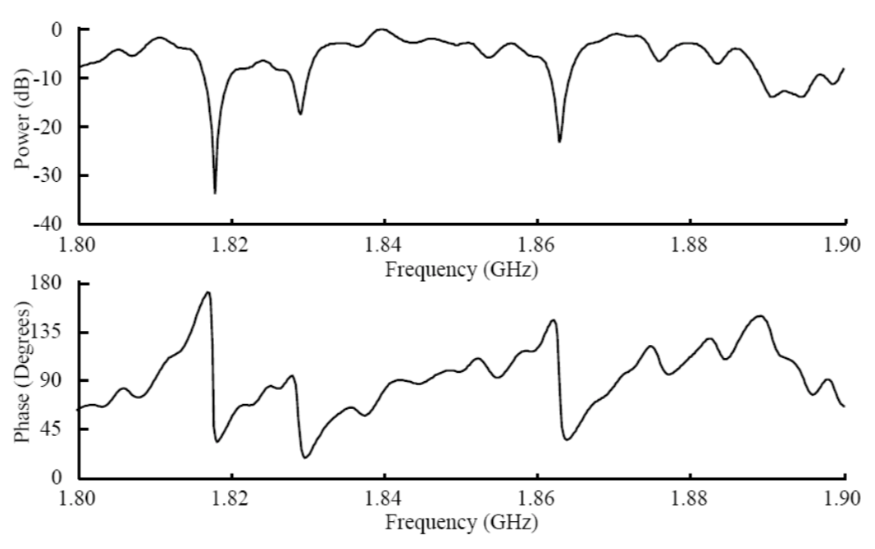
Frequency Selective Channel
Deep notches with 5-7MHz width
Notch width inversely proportional to rms delay spread
In frequency domain: the time delay spread creates deep frequency notches
In time domain: the time delay spread produces Inter Symbol Interference (ISI)
ISI: signal is distorted due to one symbol interferes with subsequent symbols. Results in errors in decision device at Rx.
Notes:
Frequency is rate of change of phase

Slide 23
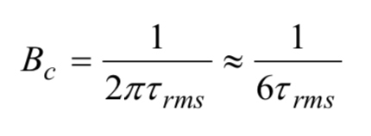
Exponential model
PDP assumed to follow an exponential profile → Approximated coherence bandwidth:
Notes:
All equations good for systems with dominant strong Line of Sight (satellite and microwave p2p comms…where multipaths with mobile radio apps not that good

Slide 24

Wideband System
Channel bandwidth is far in excess of the channel’s coherence bandwidth. Allows higher bandwidth and faster communication.
Narrowband System
Channel bandwidth is less than the channel’s coherence bandwidth.

